Slide 1

Spotify Top songs analysis and trends
A detailed report of the process, insights and recommendations.

Slide 2
OUTLINE
Introduction
Data Source
Data Content
Tools Used for Data Analysis and Documentation
Data Cleaning
Data Analysis
Data Visualization/Insights
Recommendation
Conclusion

Slide 3
INTRODUCTION
Founded in 2006, Spotify is a leading global music streaming platform that revolutionized how people access and enjoy music. With over 574 million users worldwide, including 226 million subscribers, Spotify offers a vast library of songs, podcasts, and playlists tailored to individual preferences. Its data-driven approach, powered by advanced algorithms, enables personalized recommendations and insights into music trends. Today, Spotify is not just a streaming service but a cultural hub shaping the music industry and listener experiences.

Slide 4
DATA SOURCE
The data was a spotify top songs dataset downloaded from Kaggle.
This dataset contains audio statistics of the top 2000 tracks on Spotify from 2000-2019. The data contains about 18 columns each describing the track and it's qualities.

Slide 5
DATA CONTENT
Artist: Name of the artist.
Song: Name of the track.
Duration_ms: Track duration in milliseconds.
Explicit: Indicates if the track contains offensive or unsuitable content for children.
Year: Release year of the track.
Popularity: Higher value = more popular song.
Danceability: Measures how suitable the track is for dancing (0.0 = least, 1.0 = most).
Energy: Measures intensity and activity (0.0 = low, 1.0 = high).
Key: The musical key of the track (e.g., 0 = C, 1 = C♯/D♭).
Loudness: Overall loudness of the track in decibels (dB), averaged across the track. Values range from -60 (quiet) to 0 (loud).
Mode: Modality of the track: 1 = major, 0 = minor.
Speechiness: Detects spoken words in a track. Closer to 1.0 = more speech-like (e.g., talk shows, rap).
Acousticness: Confidence measure (0.0 to 1.0) of whether the track is acoustic. 1.0 = high confidence.
Instrumentalness: Predicts if a track has no vocals. Closer to 1.0 = higher likelihood of no vocals.
LIveness: Detects audience presence. Higher values (e.g., >0.8) indicate a live performance.
Valence: Measures musical positiveness (0.0 to 1.0). Higher values = happier, more positive tracks.
Tempo: Overall estimated speed of the track in beats per minute (BPM).
Genre: The musical genre of the track.

Slide 6
TOOLS USED FOR DATA ANALYSIS AND DOCUMENTATION
Data Cleaning- Microsoft Excel
Data Visualization- Power Bi
Data Documentation-Powerpoint

Slide 7
DATA CLEANING
Microsoft excel was used to clean the data.
We imported the dataset into power query.
We checked for the data type in each column and made corrections to the ones that weren’t in the right format.
We removed duplicates from the dataset.
We checked missing values.
We corrected inconsistencies such as wrong spelling in the artist column.

Slide 8
DATA ANALYSIS
Research questions
Who were the most popular artists?
What was the trend of explicit songs over the years ?
What was the percentage of explicit and non-explicit songs?
What was the popular genre?
What was the relationship between tempo and danceability?
Which genre had the highest number of artist?
What were the songs recorded live?
Which year had the most top songs?

Slide 9
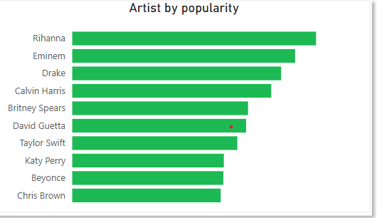
DATA VISUALIZATION/INSIGHT
The bar chart on the right shows the top 10 most artists based on the streams in the 2000’s . Some artists have significantly higher popularity that others, indicating that a few top artist dominate audience attention.

Slide 10
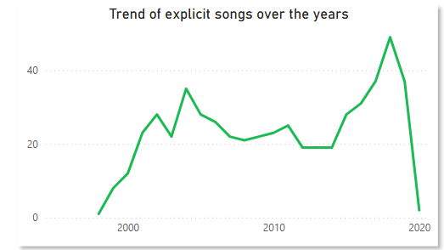
DATA VISUALIZATION/INSIGHT(S)
The line chart on the right shows the trend in explicit songs over the years. The trend shows a general rise in explicit songs from the late 1990s to around 2020, indicating a growing acceptance or demand for explicit content. there is a sharp drop in explicit songs around 2020, which could be influenced by industry regulations, changing audience preferences, or shifts in artist content

Slide 11
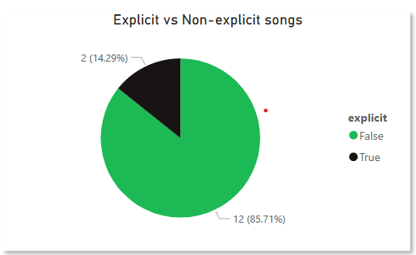
DATA VISUALIZATION/INSIGHT(S)
The pie chart on the right shows the percentage of Explicit to Non-explicit songs. Despite the rise in the trend of explicit songs over the years, the chart shows that 85.71% of songs are non-explicit, indicating that clean content dominated the music landscape.

Slide 12
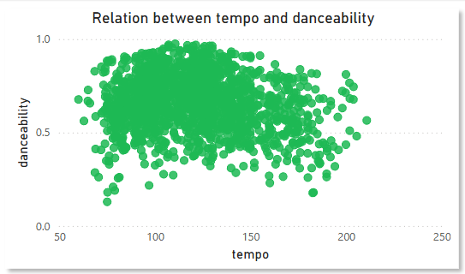
DATA VISUALIZATION/INSIGHT(S)
The scatter plot shows a wide spread of data points, indicating that danceability is not strictly dependent on tempo. Songs with different tempos can still be danceable. This also suggests that a significant number of songs were dance-friendly.

Slide 13
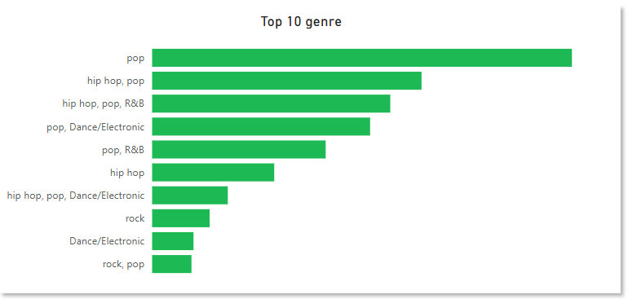
DATA VISUALIZATION/INSIGHT(S)
The bar chart shows the Top 10 genres. Pop music is not only dominant, it appears most frequently in the top genres, often combined with other genres like hip-hop, R&B, and Dance/Electronic, indicating its widespread appeal and versatility. This also indicates genre fusion is important.

Slide 14
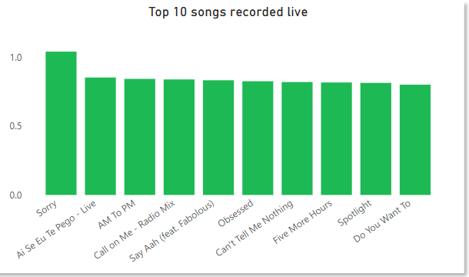
DATA VISUALIZATION/INSIGHT(S)
The column chart on the right shows the top 10 live-recorded songs which include a mix of pop, hip-hop, dance, and Latin music, indicating that live performances appeal across multiple genres. Among the top 10, "Sorry" has the highest metric and it’s artist was/is till one of the top performers in the music industry.

Slide 15
RECOMMENDATIONS
Spotify could collaborate with these most popular artists for promotions, playlists, or exclusive content to increase streams. They could also promote upcoming artist by suggesting their music to the audience.
Spotify should assess whether explicit content remains a key attraction or if audiences are shifting toward cleaner lyrical content due to fluctuations in trends. The sharp decline in 2020 could also be due to stricter content guidelines
Spotify should continue prioritizing clean content as this appeals to a wider audience including younger listeners while balancing explicit content for niche audiences.
Spotify and creators can analyze other song attributes (such as genre and energy levels) to curate playlists or recommendations that align with listeners' dance preferences.

Slide 16
RECOMMENDATIONS
Spotify could suggest to producers to focus on other elements like rhythm, beat patterns, and song structure to enhance danceability, since tempo alone does not determine danceability
Spotify(streaming platforms) and music curators should create playlists that feature a mix of pure and blended genres to cater to listeners' evolving tastes.
As live recordings gain traction, artists and labels should consider releasing live versions of hit songs to engage fans in a unique way.
Spotify and artists can collaborate to capitalize on the demand for live recordings by offering high-quality concert albums or exclusive live-streamed performances.

Slide 17
CONCLUSION
The data visualization project based on Spotify's track data has revealed several valuable insights into the music industry specially during the specified time frame. By utilizing various graphical representations, We have gained a deeper understanding of the distribution of song characteristics, the popularity of different genres and artists, and trends in listening behavior over time.
The findings show that danceability, energy, and valence play significant roles in a song's popularity, with hip-hop and pop emerging as the most streamed genres on Spotify.
Additionally, we observed a steady increase in the number of streams over the years, reflecting the growing trend of Spotify and other digital music streaming services.

Slide 18
THANK YOU!!!

